Slide 1
Financial Success Routine
Provided by the LAUSD Food Services Division
07.23.2015
Notes:
PLACEHOLDER

Slide 2
Financial Success Routine
Provided by the LAUSD Food Services Division
Notes:
Tell: Thank you for attending the Financial Success Routine training. Before we begin please complete the pre-quiz located in your binder/notebook. Answer the questions to the best of your ability. We will review the pre-quiz answers together before beginning this presentation. There will be a quiz at the completion of this training to assess what you have learned.

Slide 3
Objectives
Attendees will learn how to access and utilize Daily/Weekly/Monthly electronic reports that help ensure financial success and operational compliance.
Notes:
TELL: During this training you will learn how to access and utilize the Daily, Weekly, and Monthly electronic reports to ensure financial success and operational compliance.

Slide 4
Purpose of Financial Success Routine
The purpose of the financial success routine is a tool developed to confirm that organizational procedures are being followed to validate:
Operational compliance
Productivity
Accountability
Accuracy
Inventory Management
Notes:
TELL: The purpose of conducting a financial success routine is to confirm that organizational procedures are being followed to validate operational compliance, productivity, accountability, accuracy and inventory management.

Slide 5
Definition of Success Routine
A Success Routine is a “travel path” that when utilized, confirms that operational requirements are followed.
Provides an oversight to ensure people handle company money and assets appropriately
Notes:
TELL: What is a Success Routine? A Success routine is defined as a “travel path” that when utilized, confirms that operational requirements are followed. The success routine provides an oversight to ensure people handle company money and assets appropriately.

Slide 6
Overview of the Process
The success routine is used to monitor reports to ensure that accurate information is documented.
Reports serve as a self audit tool to review figures for the week:
All In One Reports
Additional individual self audit reports
CMS Finish Line
Café LA Success Routine
Notes:
TELL: The success routine process is used to monitor reports to ensure that accurate information is documented. Reports serve as a self audit tool in order to review figures for the week. In this training we will be covering the All In One Reports, additional individual self audit reports, the CMS finish line and the Café LA success routine that Area Food Services Supervisors (AFSS) use to monitor your sites.

Slide 7
All In One Report
The All In One Report consists of four categories and is used as a self audit to double check figures for accuracy :
Bank Deposits
Edit Check
Production Record
Till Report
NOTE: Adjustments should be made immediately and stored in a folder on the desktop
Notes:
TELL: The All In One Report consists of four categories and is used as a self audit to double check figures for accuracy. Here are the 4 reports included in the All in One. Bank Deposits, Edit Check, Production Record, and Till Report. NOTE: After analyzing the reports, if you have found any errors, the necessary adjustments should be made immediately. Then the All in One reports should be stored in a folder on the desktop.

Slide 8
Bank Deposit Report
Compare the information entered into CMS with the amount on the bank deposit slip.
Both amounts should match
Any discrepancies must be investigated and corrected
Notes:
TELL: Let’s review the bank deposit report from the example, here the cash sales are $5.50, posted $5.50, daily deposit $5.50 and bank deposit $5.50. This report is good and balanced.
Your goal is to ensure that transposed numbers are caught and corrected. A typical error could be that $5.05 is entered instead of only $5.50; both amounts should match. Any discrepancies must be investigated and corrected.

Slide 9
Edit Check Report
The edit check report displays the number of eligible applications by type, meal counts, participation percentages by type, attendance factor, meal period totals, and enrollment information for the date.
Review this report daily
Record any reason(s) that the figures are not compliant
Notes:
TELL: The edit check report displays eligible applications, meal counts, participation percentages, attendance factor, meal period totals, and enrollment for the date selected categorized by free, reduced and full price eligibility. Review this report daily and record any reason that the figures are not in compliance.

Slide 10
Edit Check Activity
Analyze the Edit Check Report below to determine the causes for the “Out of Compliance” results.
Notes:
TELL: This is an example of an edit check report that has meal counts that are out of compliance . Let’s analyze the report for November together. According to the eligible applications the maximum meals that can be counted against a free eligibility for lunch is 138. However, on this day the report indicated meals are recorded for 153 free eligible students. In this report we can identify that 15 meals are being recorded over the maximum and this is the reason why lunch meal count is out of compliance. Also note that besides meal count a factor could also be that MiSiS eligibility information has not communicated in CMS. Now, let’s move on the activity.

Slide 11
Activity
Click here when all 4 answers are selected.
Click on all steps in identifying the reasons for your site being out of compliance?
After you have selected the four answers click on blue box at the corner.
Verify Inventory
Provision 2, Year 2+ school
POS not communicating
Incorrect
Correct
Incorrect
Verify Attendance
Excessive Non Reimbursable Meals
Easy steps not forecasted
Correct
Incorrect
Incorrect
Verify Bank Deposit
MISIS is not current with CMS
Meal Counts
Incorrect
Correct
Correct
Notes:
TELL: Based on the training so far, what are the possible reasons your school site is out of compliance? Please click on all four correct reasons for a site to be out of compliance. After you have selected the four answers click on the blue box in the top right hand corner.

Slide 12
Correct!
Provision 2, Year 2+ school
Meal Counts
Verify Attendance
MISIS is not current with CMS
Click here to continue
Notes:
TELL: Correct, the factors contributing to out of compliance are MISIS-CMS information, meal counts, P2, years 2 plus schools and attendance. Click in the box to continue.

Slide 13
Incorrect!
Verify Inventory
POS not communicating
Easy steps not forecasted
Verify Bank Deposit
Excessive Non Reimbursable Meals
Try again
Notes:
TELL: Incorrect , Click on the box to try again.

Slide 14
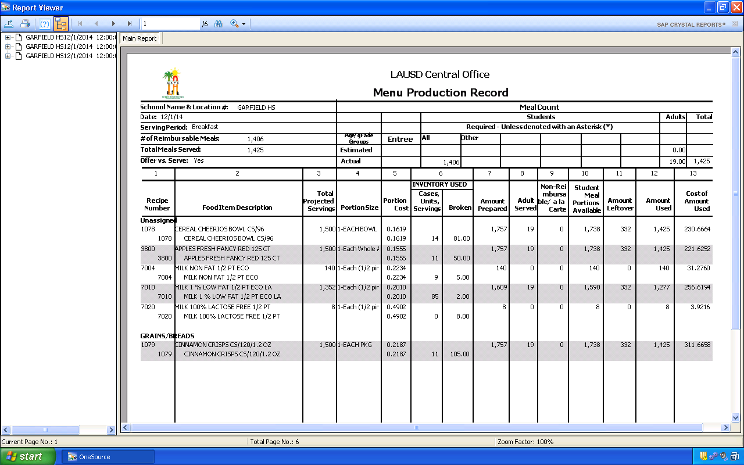
Menu Production Record
The menu production record provides written history of the meals prepared, served and leftover.
Verify the number of reimbursable meals and total meals served were entered correctly
The correct portion size is indicated by individual serving , not the case or basket count
Notes:
TELL: The Menu Production Record is the end result of transferred data from the production worksheet. Menu production record provides written history of meals prepared, served and leftover.
Verify the number of reimbursable meals and total meals served were entered correctly. The common error identified on the production record is the portion size. It must indicate each or serving not case or basket for the portion size. The portion size will affect your portion cost, if you notice a large dollar amount in column 5 that means your portion size may be incorrect. You would then need to re-open your production record and fix the mistake. It is critical to look at all columns to ensure all figures have been transferred from production worksheet accurately.
NEXT SLIDE

Slide 15
Till Report
The Till Report will list all open CMS terminal activity for the day. Review the till report to ensure:
All tills have been closed correctly
The variance is balanced
All discrepancies are resolved
Notes:
TELL: The Till Report will list all of the till’s activity for the day. Review the till report to ensure that all tills have been closed correctly and balanced. If the total variance is over or short, communicate with cashier to determine the reason for the discrepancy. All discrepancies must be resolved. Document any unresolved discrepancies on the CMS bank deposit memo section.

Slide 16
Additional Reports Available
Additional reports are available in CMS that can be used to double check the accuracy of:
Meal Counts (Daily)
Shopping List Audit (Weekly)
Receiving and Stock Transfers (Weekly)
Production Audit (Weekly)
Profit and Loss (Weekly)
Physical Inventory (Monthly)
NOTE: These reports do not need to be printed nor saved
Notes:
TELL: The Cafeteria Management System has additional reports available to assist you in conducting self audits. Review the meal count report daily. Shopping list audit, receiving and stock transfers, production audit and profit and loss reports are reviewed weekly. The physical inventory report is the only report viewed monthly.
The reports are used to double check figures entered manually for accuracy. If you notice a discrepancy in any of these reports corrections must be made immediately. These reports do not need to be printed, or saved to your desk top.

Slide 17
Meal Count Report
The Meal Count Report will list POS terminal’s activity for the day. Review the report to ensure:
All POS terminals communicated to the managers computer
Meals reported coincide with the amount of food taken from each POS
“Reimbursable totals” on the meal count report match the “# reimbursable meals” entered into the “ALL” field on the MEALS/REVENUES tab on Daily Production
Note: “Total meals” indicated on the meal count report may not match the “amount used” on the production worksheet.
Notes:
TELL: The Meal Count Report will list POS terminal’s activity for the day. Review the report to ensure: that all POS terminals communicated to the managers computer, the meals reported coincide with the amount of food taken from each POS and that the “Reimbursable totals” on the meal count report match the “# reimbursable meals” entered into the “ALL” field on the MEALS/REVENUES tab on Daily Production. Note: “Total meals” indicated on the meal count report may not match the “amount used” on the production worksheet.

Slide 18
Shopping List Audit
The Shopping List Audit will list the status of the orders (No Order, Open, Completed, Consolidated, Missing or NDD):
Review to determine the status of the orders
Verify information listed
Complete any outstanding orders
Notes:
TELL: The shopping list audit will list the status of the orders such as no order, open, completed, consolidated, missing and non delivery date. Review the report to determine the status of the orders and verify information listed and/or complete any outstanding orders.
Let’s review the columns: “no order” means no order is needed for that vendor, the “open” column indicates that a shopping list is still open and needs to be completed, “completed” means your shopping list is marked complete and ready for consolidation, “consolidated” indicates that the shopping list has been consolidated at central office, “missing” means the shopping list is missing for the vendor and date, and “NDD” stands for Non Delivery Date, which implies that the order was placed on the wrong delivery day. You should be aware of what vendor you are ordering from. This report will vary from site to site. If you have a missing shopping list, complete if needed. An example would be a Chemical order, whereas they are not ordered on a regular basis. So, this would show missing when it is not ordered.

Slide 19
Receiving and Stock Transfers
Vendors are paid only after Food Service Managers confirms receipt of the goods and invoices are verified by Café Fiscal.
Complete the receiving and stock transfer in CMS
Complete receiving tickets each day that you receive a delivery
Review the receiving and stock transfer to ensure no outstanding receiving tickets are pending
Notes:
TELL: Vendors are paid for goods received only after invoices are verified and the Food Service Manager/designee confirms receipt of the food and/or supplies. This is done by completing the receiving and stock transfer process in CMS. Review the receiving and stock transfer to ensure no outstanding receiving tickets are pending from the vendors. Complete receiving tickets daily if you receive a delivery.

Slide 20
Production Audit
The production audit allows the Food Service Manager/designee to review the status of production records.
N - Not Created
O - Created
P - Created and has served quantities
C - Completed has served quantities
E - Completed without served quantities
Notes:
TELL: The production audit allows the Food Service Manager/ designee to review the status of the production records. The following codes are utilized N, Not created, O, created, P, created and has served quantities, C, complete and has served quantities E means completed without served quantiles. The ultimate goal is that all production records are marked C on a daily basis.

Slide 21
CMS Production Profit and Loss Report
The CMS Production Profit and Loss Report is a tool used by managers to see how well the operation is performing.
The report allows you to view:
Number of Meals served
Food cost
Total cost per meal
Per meal profit/loss
Total profit/loss
Notes:
TELL: The CMS Production Profit and Loss Report is a tool used by managers in daily operation. With the P&L trend you can see how well your operation is running; as well as where you are spending or wasting too much. The Profit and Loss Report allows you to view meals served, food cost, total cost per meal, per meal profit/loss and total profit/loss. The average meal cost for Breakfast is $1.02, lunch is $1.70, snack is $0.51 and supper is $1.70. Pay attention to the meals served and total cost per meal when analyzing this report.

Slide 22
Physical Inventory Dates Report
The Physical Inventory Dates Report lists dates that creation, completion and approval were conducted to complete the monthly inventory.
Review the Physical Inventory Dates Report to ensure:
Date listed is correct
Under Type “wall to wall” is listed
“Yes” is under site complete and the date the inventory was completed is indicated under “complete”
Notes:
TELL: The Physical Inventory Dates Report will list the dates for creating and completing the monthly inventory as well as the approval information. Review the Physical Inventory Dates Report to ensure the correct physical inventory date is listed; the type listed should be “wall to wall” which means that it is for all items from the refrigerator, freezer and all store rooms.
The inventory is completed by an indication of “yes” and the “date” it was completed.

Slide 23
Physical Inventory Dates Report cont.
Continue reviewing the Physical Inventory Dates Report ensuring:
“Yes” is indicated under Management Approved
The “date” listed under Created, Complete, Approved and Updated is correct
There will not be information displayed under Inventory Updated if no changes were made
Notes:
TELL: Let’s continue reviewing the Physical Inventory Dates Report to ensure that “Yes” is indicated under Management Approved and that the “date” listed under Created, Complete, Approved and Updated is correct. Be aware that there will not be information displayed under Inventory Updated if no changes were made.

Slide 24
CMS FINISH LINE CHECKLIST
Notes:
TELL: This is an example of the CMS Finish Line checklist, we will discuss in detail what needs to be completed daily, weekly and monthly in the next couple of slides.

Slide 25
CMS Finish Line Checklist
The CMS Finish Line is a visual tool used to remind the manager or designee of the frequent tasks that need to be completed in CMS.
It is broken into three main sections
Daily
Weekly
Monthly
Notes:
Tell: The CMS Finish Line is a visual tool used to remind the manager or designee of the daily, weekly, and monthly tasks that need to be completed in CMS. This should be laminated and posted in a visible location near the managers work space.

Slide 26
CMS Finish Line – Daily
Daily Duties and Processes include:
Entering
Daily Production Information
Snack and/or Supper Counts
Receiving/Stock Transfers
Completing
Driftwood Orders
Manual Daily Production Worksheet
Bank Deposits
Reviewing
All In One Reports (analyze and edit if necessary)
Notes:
Tell: Daily Duties and processes include: Entering information for daily production, snack and/or supper counts and receiving/stock transfers. Completing driftwood orders, production worksheet and bank deposits. Lastly, review All In One Reports by analyzing information and editing if necessary.

Slide 27
CMS Finish Line - Weekly
Weekly duties and processes include:
Reviewing
Profit and Loss Reports
Receiving Tickets on Tuesday
Creating, Editing and Completing
Production Records
EZ-Steps
Shopping List according to the CMS Calendar
Printing
Receiving Tickets on Tuesday
Production Worksheet
Notes:
TELL: Weekly duties include review of P&L report on Monday, Print and Review receiving tickets on Tuesday, Create Production Records on Thursday and Complete EZ Steps on Fridays.

Slide 28
CMS Finish Line - Monthly
Monthly duties and processes include:
Conducting
Physical On-Site Inventory
Entering
Physical Inventory Counts
Reviewing
Physical Inventory Value Report
Completing
Inventory
Notes:
TELL: On a monthly basis conduct a physical Inventory on the last working day of month; enter counts into CMS for the current month; review physical inventory value report to ensure accuracy, edit physical inventory if necessary and mark inventory complete.

Slide 29
Sample Cafe LA Success Routine Form
Notes:
TELL: Your AFSS completes a full Café LA Success Routine report for each of their assigned sites. The Café LA Success Routine report is a tool used by the AFSS to communicate to the Food Service Manager areas of success and needed improvement. If improvement is warranted the site will have 45 days for corrective action. These reports are conducted every fiscal year according to the individual AFSS schedule. It is suggested that the Food Service Manager or designee review previous Success Routine reports and conduct their own Success Routine report to ensure they are in compliance in all areas.

Slide 30
Review
You should now know how to complete
All In One Reports
Additional individual self audit reports
CMS Finish Line
Café LA Success Routine
Notes:
TELL: During this training we have learned the correct process to be successful in regards to the banking requirements, Inventory, Production Worksheets, and the All In One Report. As a recap; bank receipts must match the deposit slips prior to entering the amounts into CMS. Your inventory needs to be accurate and up-to-date with no inventory on hand dated 6 months or older. All Production Worksheets have been completed accurately and transferred into CMS on a daily basis.
Lastly, the All in One Report is reviewed daily for accuracy.
NEXT SLIDE

Slide 31
Questions?
Notes:
TELL: Thank you for attending The Financial Success Routine training. Now we will answer any questions.

